Slide 1
Final Project Review
C4

Slide 2
Part 1: Option A

Slide 3
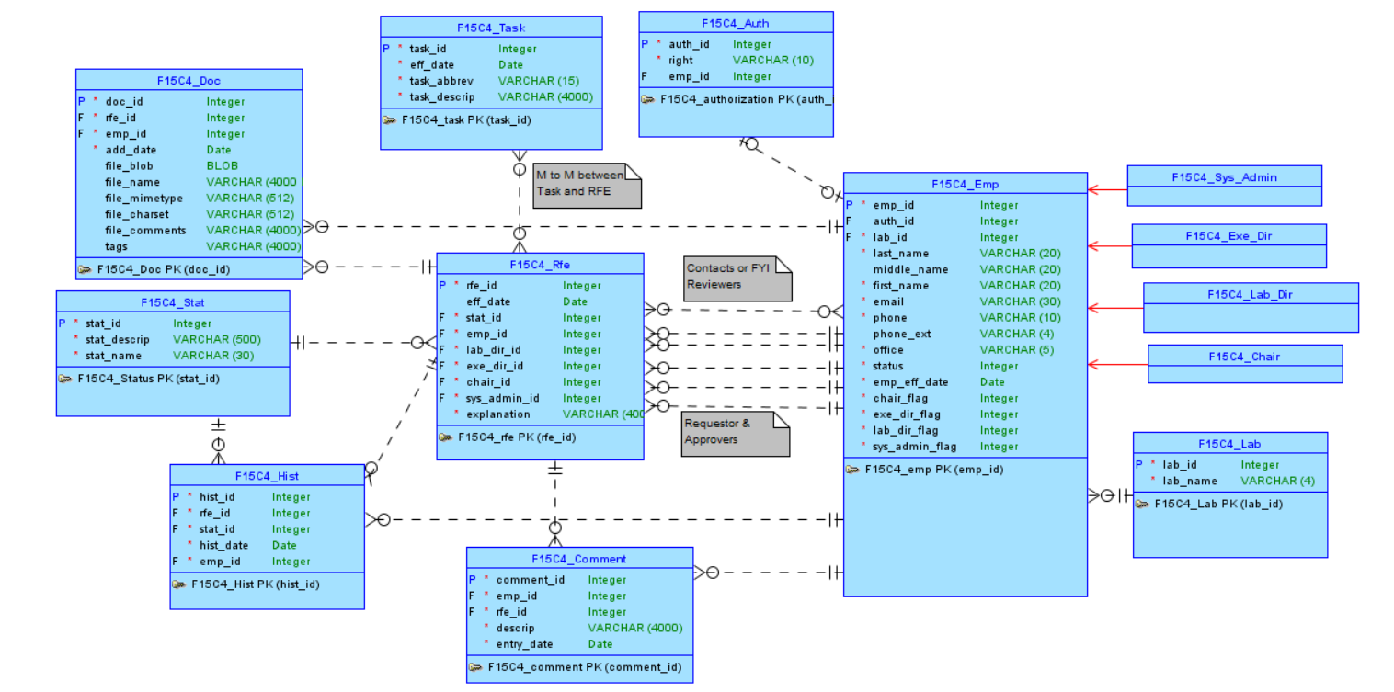
Conceptual Model
Notes:
Contacts and FYI Reviewers changed to 5 many to 1 relationships and an FYI Reviewers, easier to to work with, no joins necessary, finite number

Slide 4
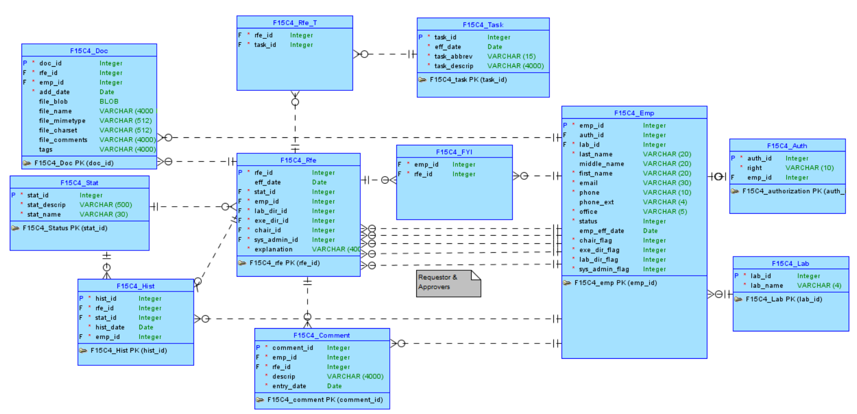
Logical Model

Slide 5
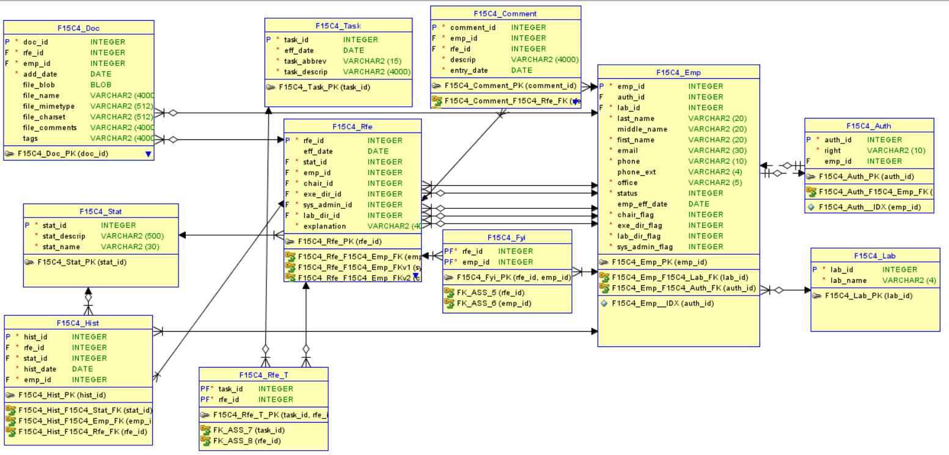
Relational Model

Slide 6
Features

Slide 7
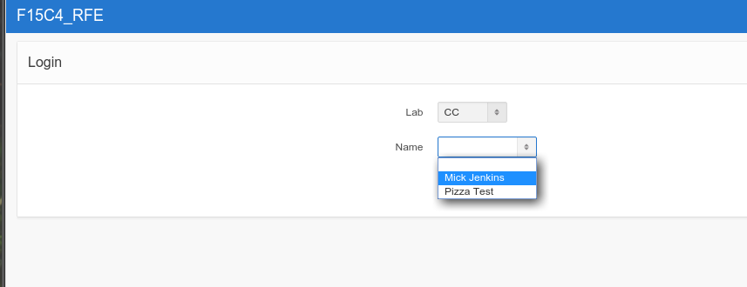
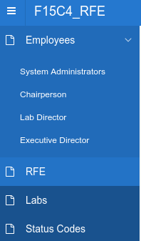
SCREENSHOTS
Navigation
Login Page
Notes:
cascading select lists

Slide 8
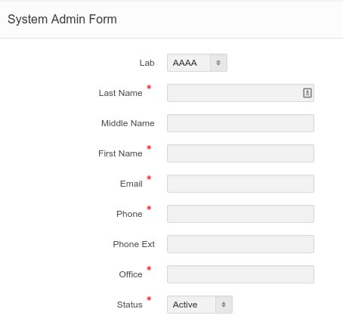
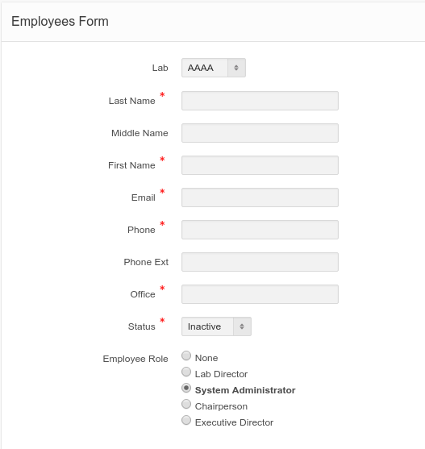
Executive Director View
Forms
Notes:
look at our select lists wow
also status is saved as a flag but look how user friendly our options are
effective date pulled in as a trigger for active employees
views do not need to specify role

Slide 9
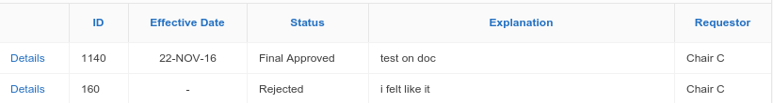
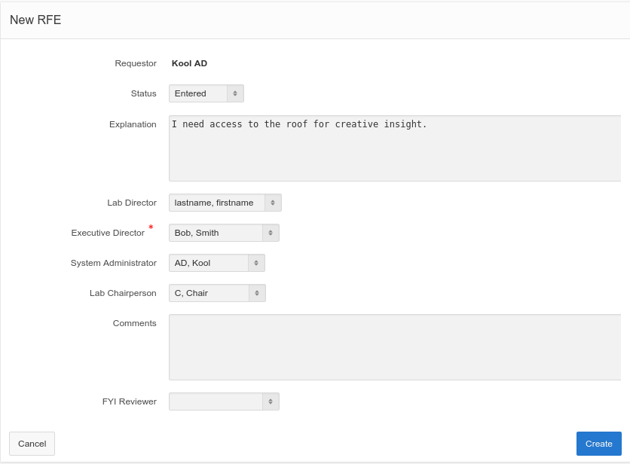
RFEs
Notes:
Employees are pulled in with triggers
optional comments and fyi reviewer
detailed RFE page

Slide 10
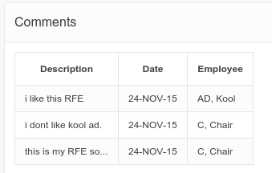
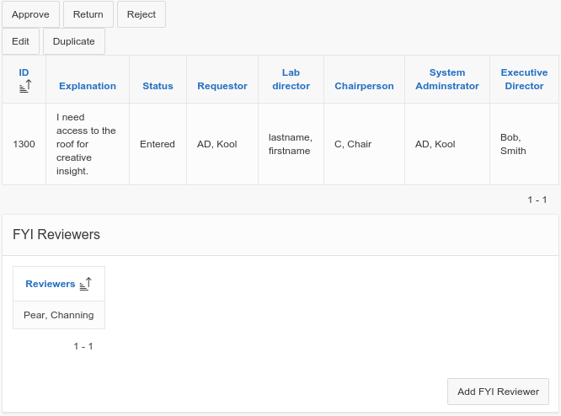
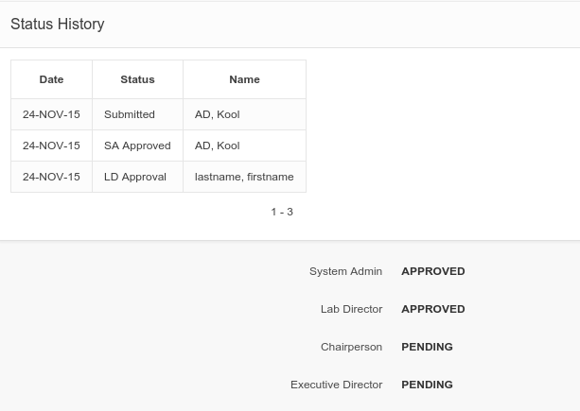
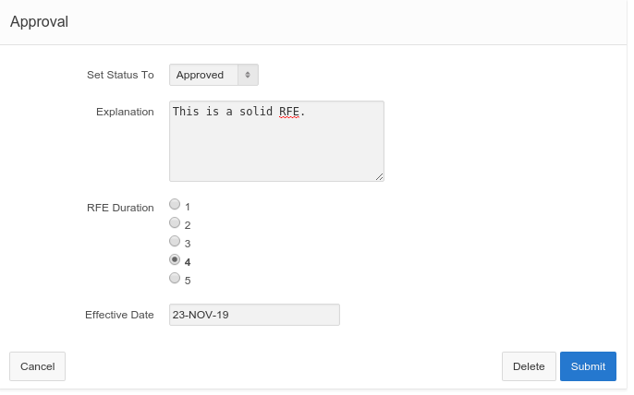
Detailed RFE page when logged in as AD, Kool
History and pending approvals after an LD Approval
Executive Director Approval Form
Notes:
dynamic action for effective date

Slide 11
Link to Application
https://apex.oracle.com/pls/apex/f?p=96655:1:119275402988701:::::

Slide 12
Part 2

Slide 13
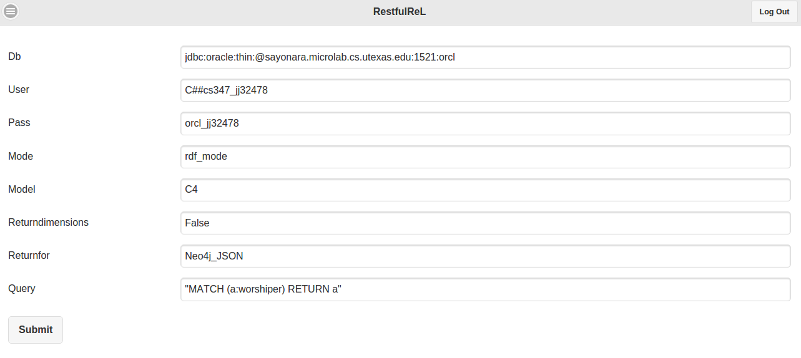
Features

Slide 14
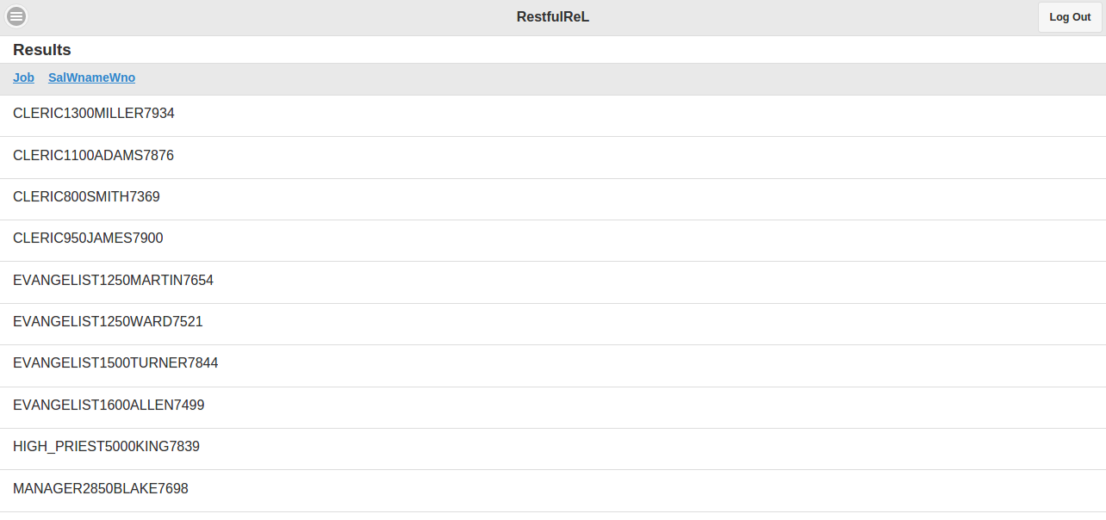

Slide 15
Link to Mobile App
https://apex.oracle.com/pls/apex/f?p=93984:2:110303103122957:::::

Slide 16
GitHub
https://github.com/jack0lantern/F15C4-RFE

Slide 17
ENDDDDDDDDDDD

